Slide 1
Cryptographic Primitives

Slide 2

Use of Cryptography in Blockchain
Blockchain make use of two types of cryptographic algorithms,
Asymmetric key algorithm
Hash functions.
Hash function are used to provide the functionality of single view of blockchain to every participant. Blockchain generally use the SHA-256 hashing algorithm as their hash function.
Hash functions have a major role in linking the blocks to one another Any alteration the block data can lead to inconsistency and break the blockchain, making it invalid. This is achieved by the property of the hash function, called the ‘avalanche effect’.

Slide 3
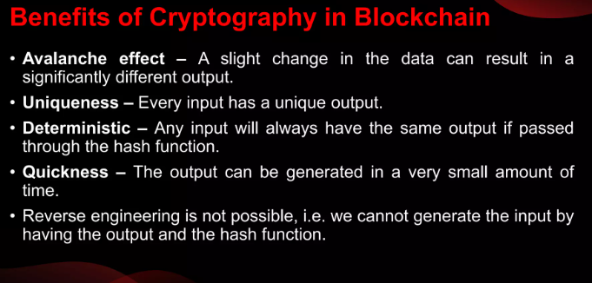

Slide 4
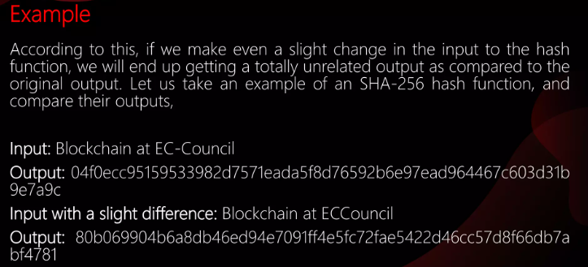
Avalanche Effect

Slide 5
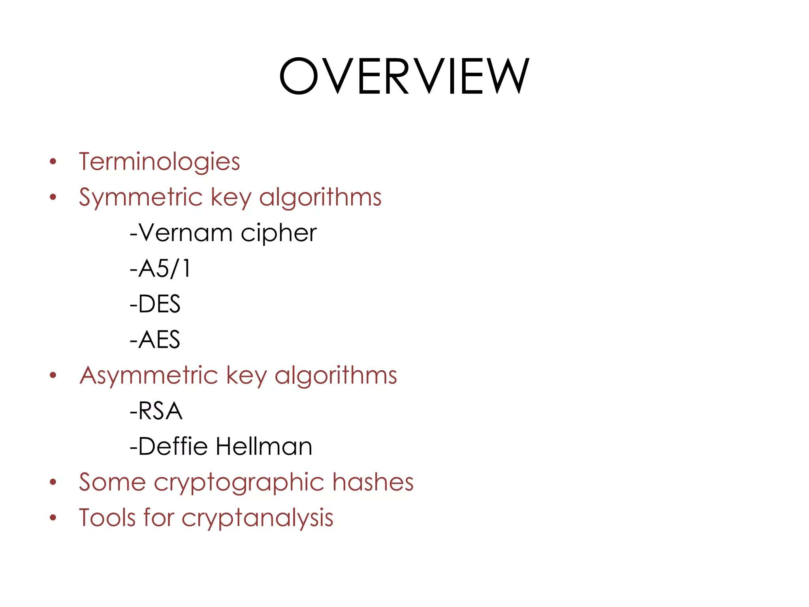

Slide 6
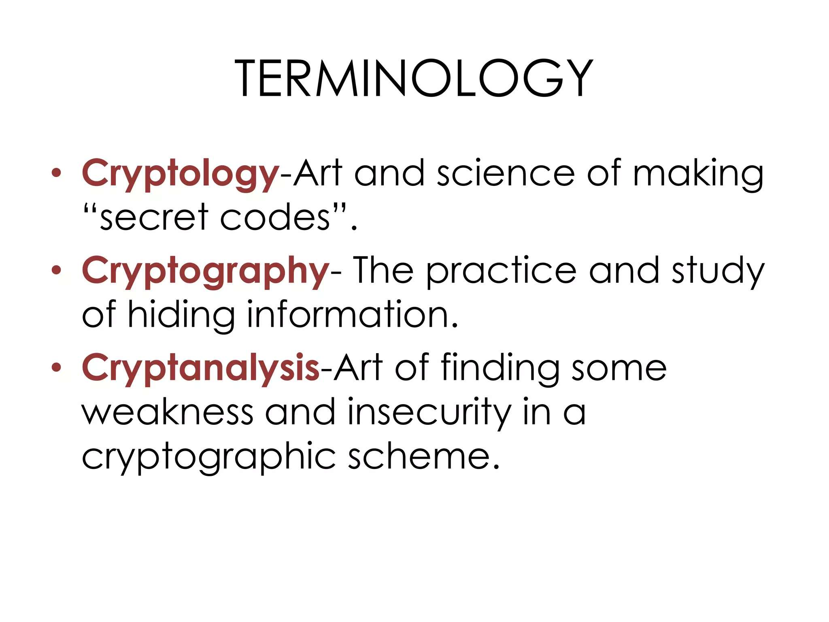

Slide 7
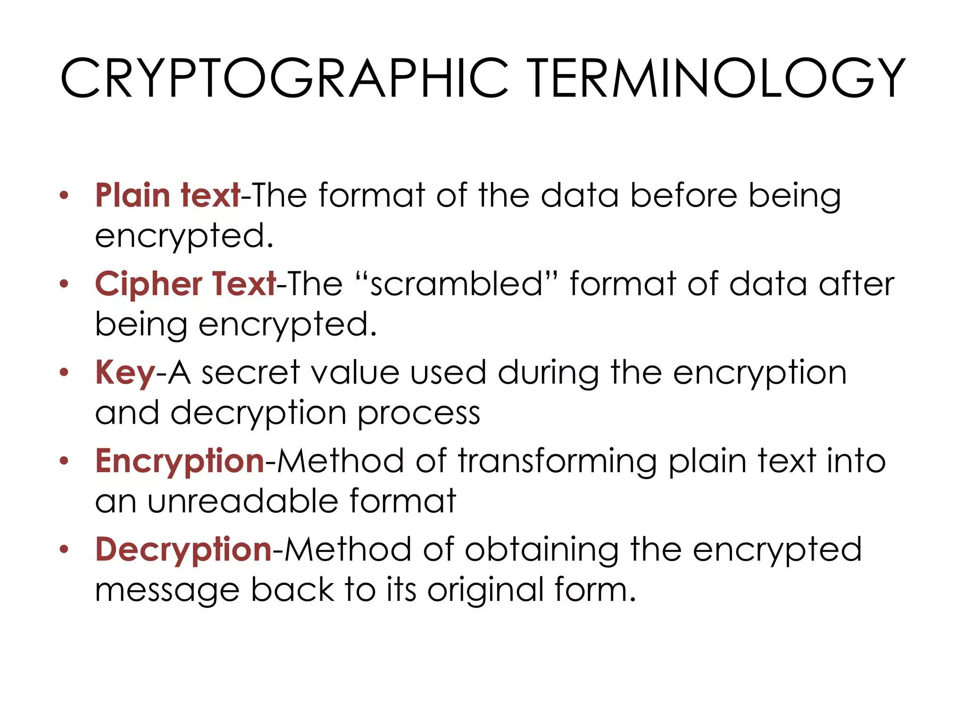

Slide 8
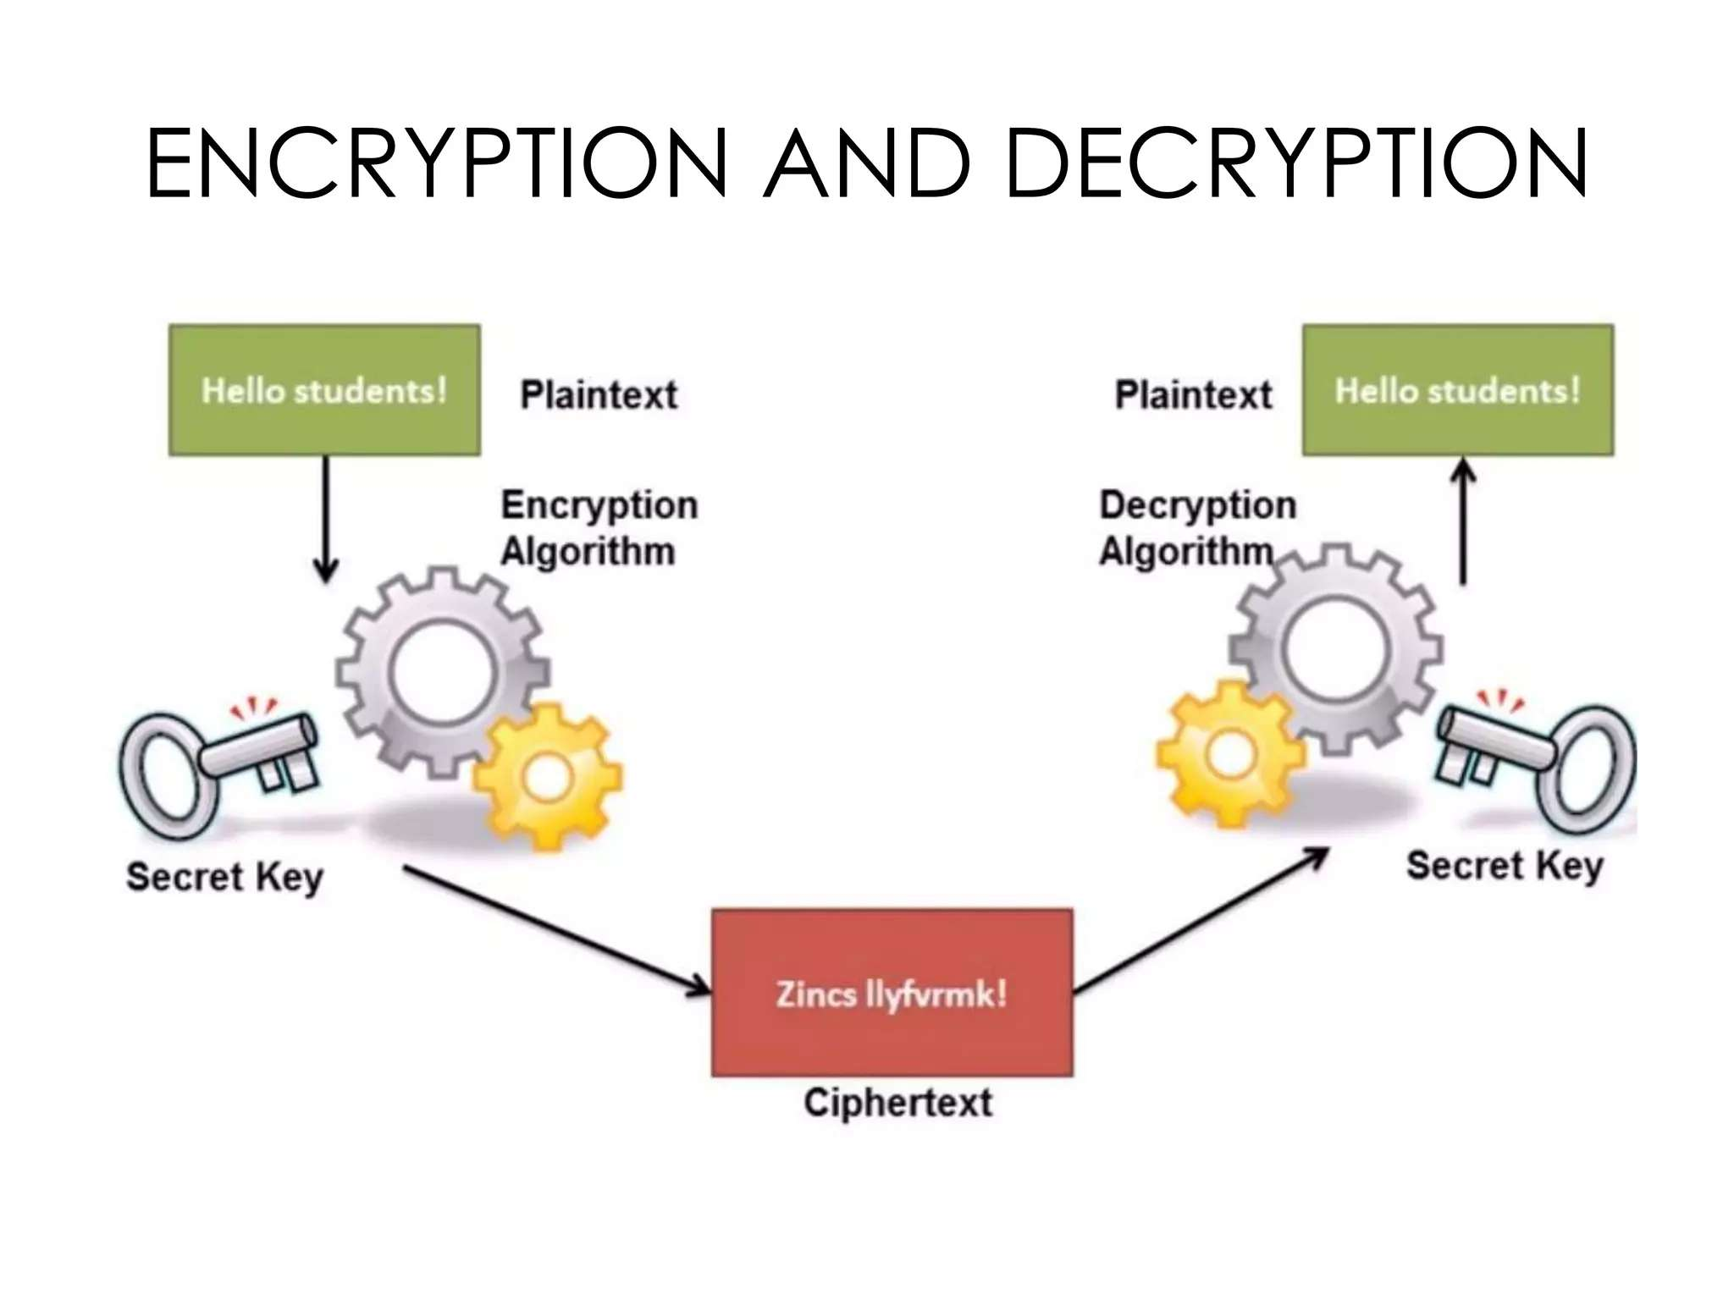

Slide 9
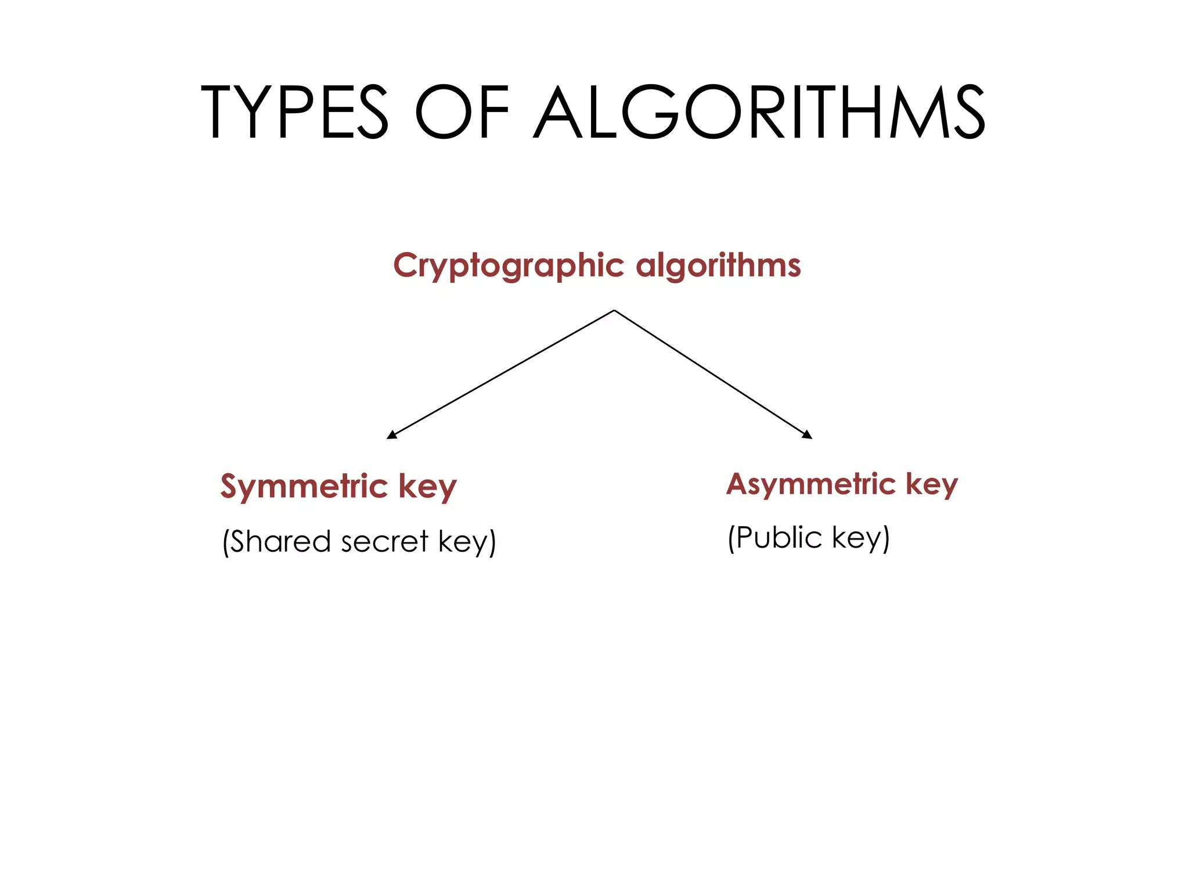

Slide 10
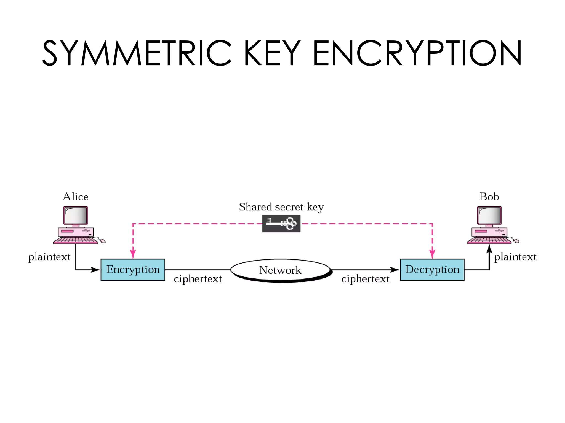

Slide 11
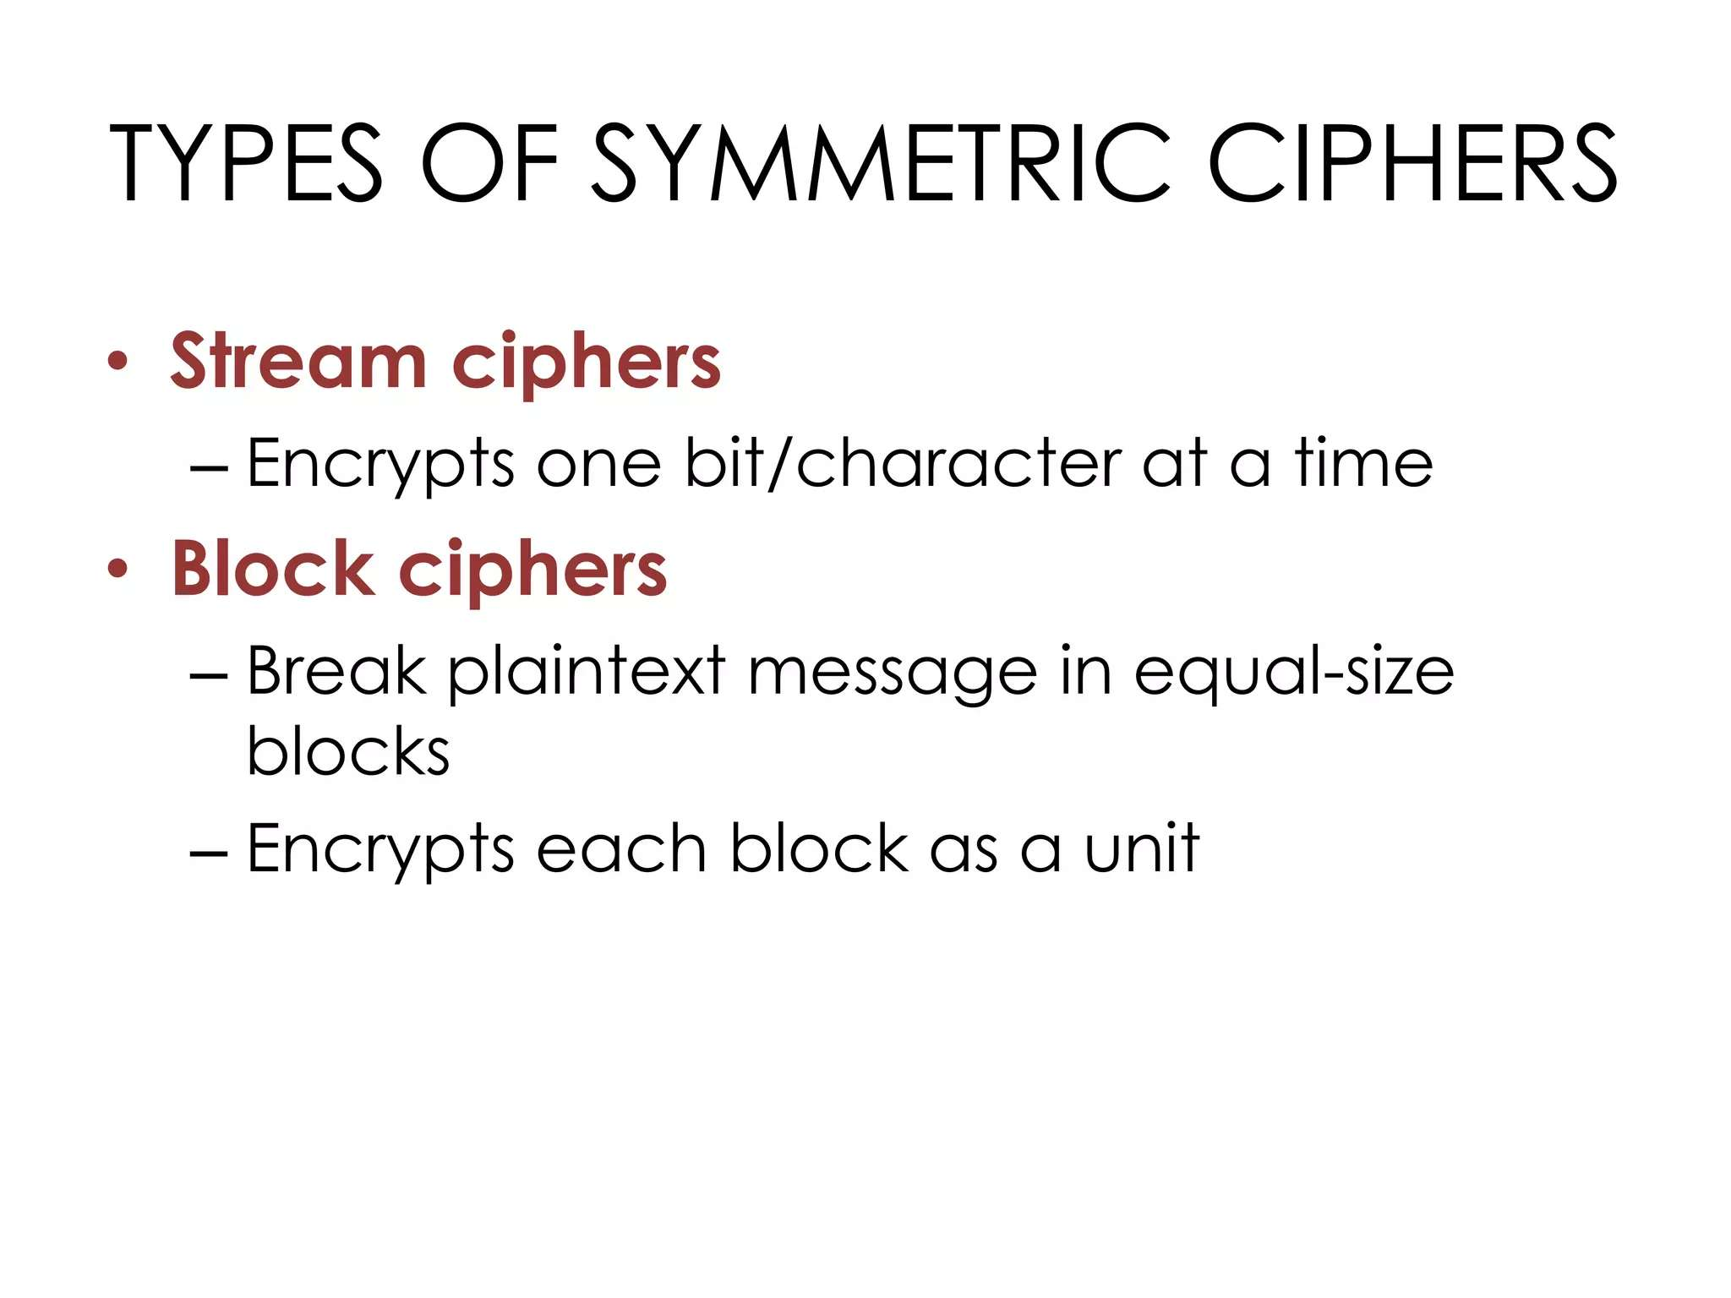

Slide 12
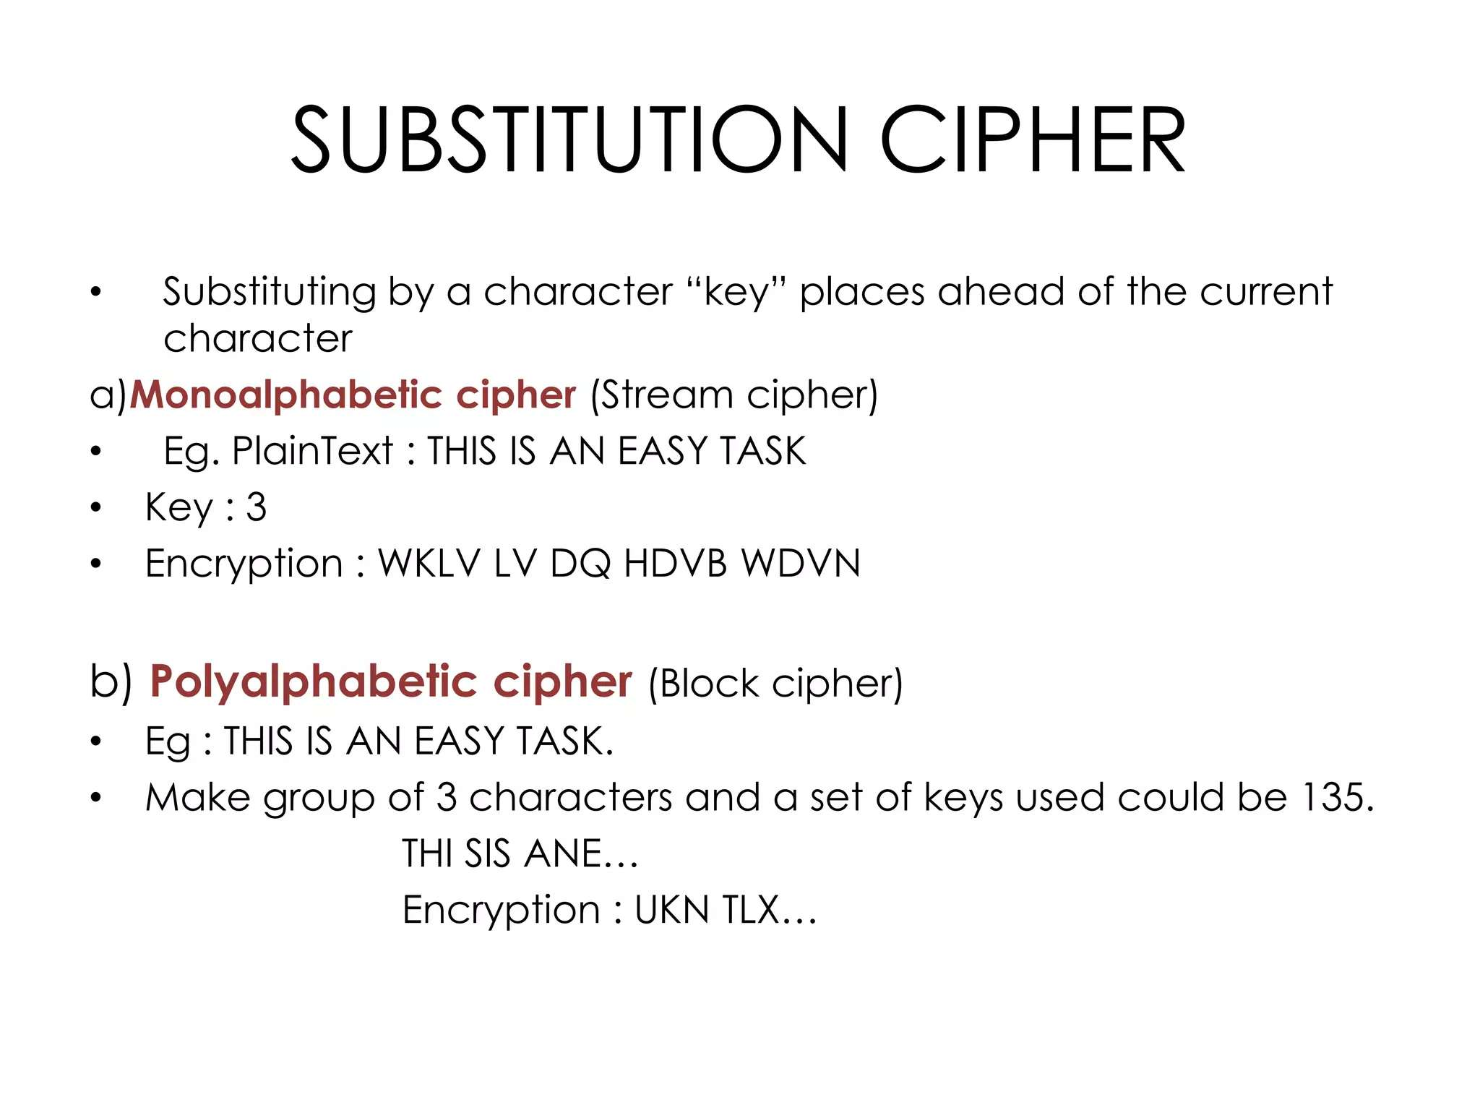

Slide 13
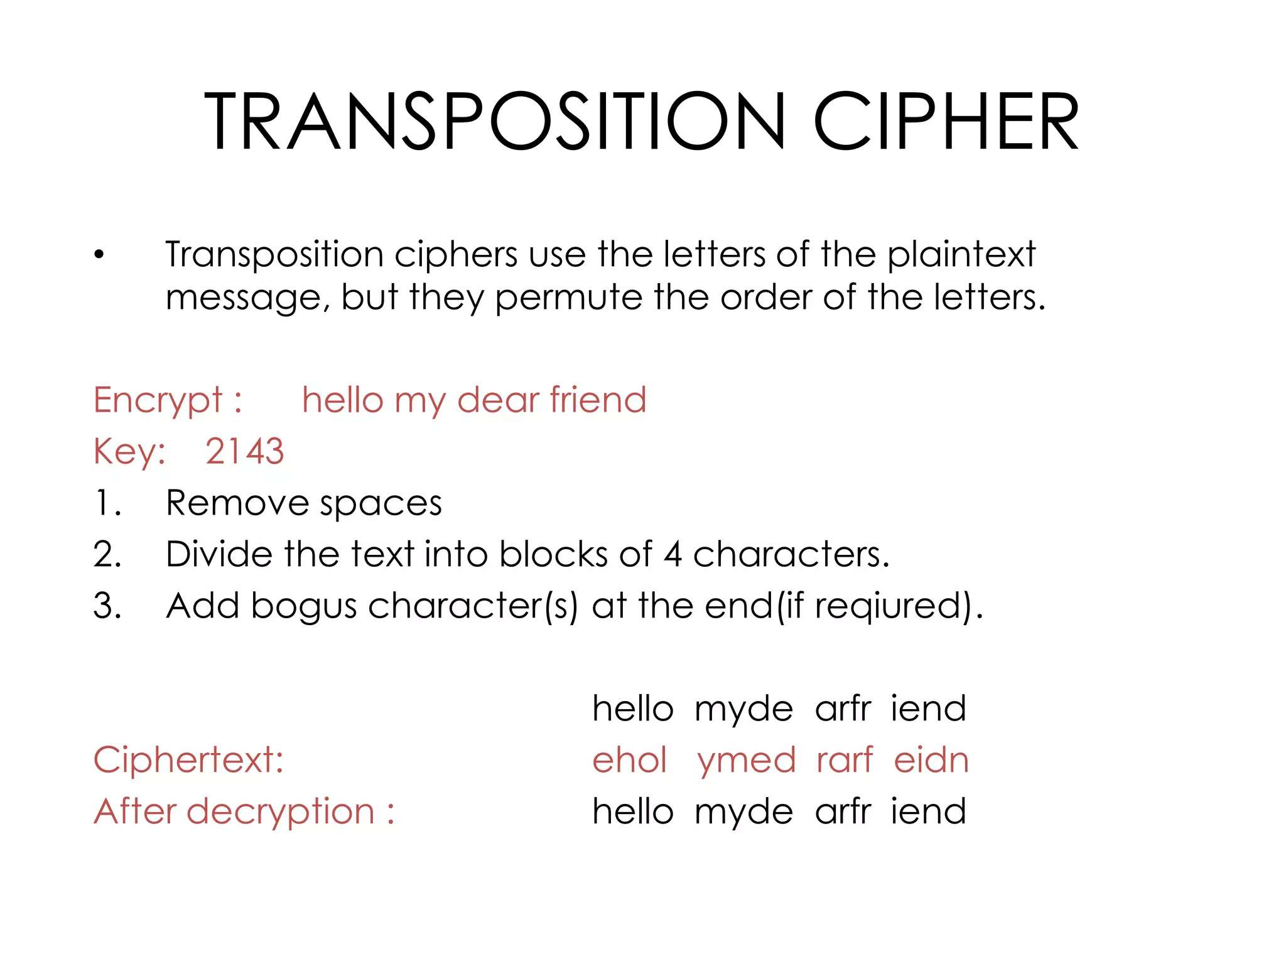

Slide 14
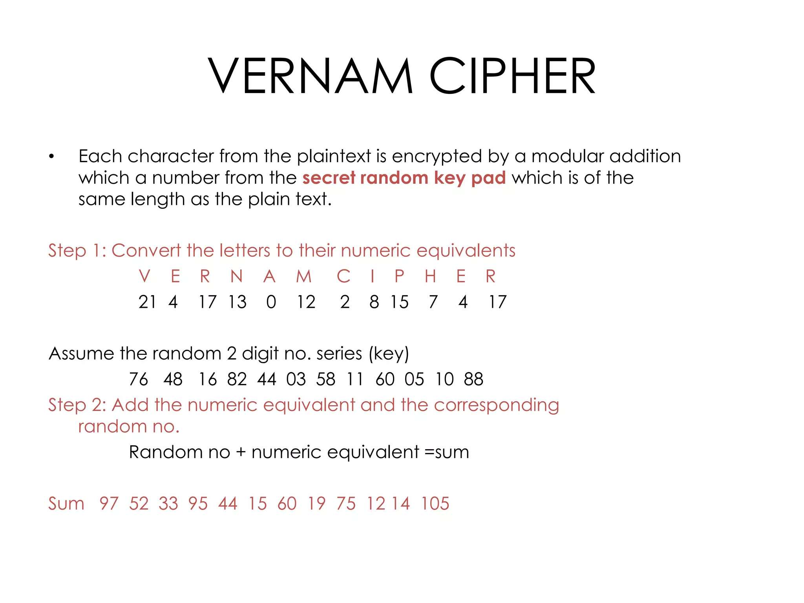

Slide 15
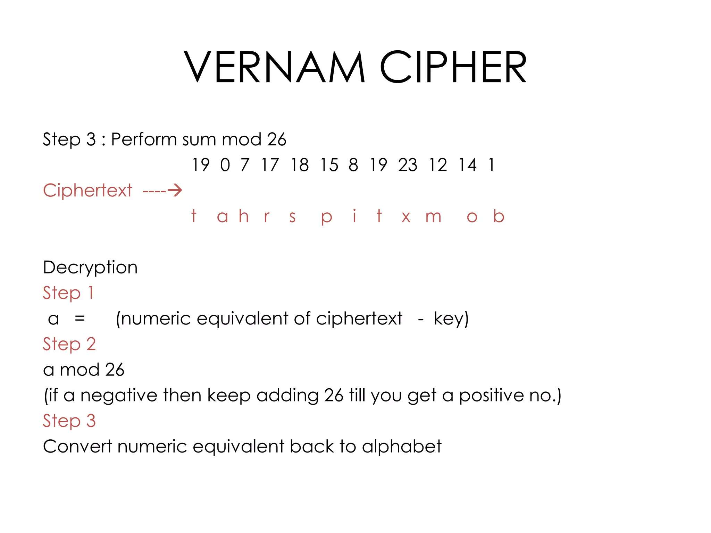

Slide 16
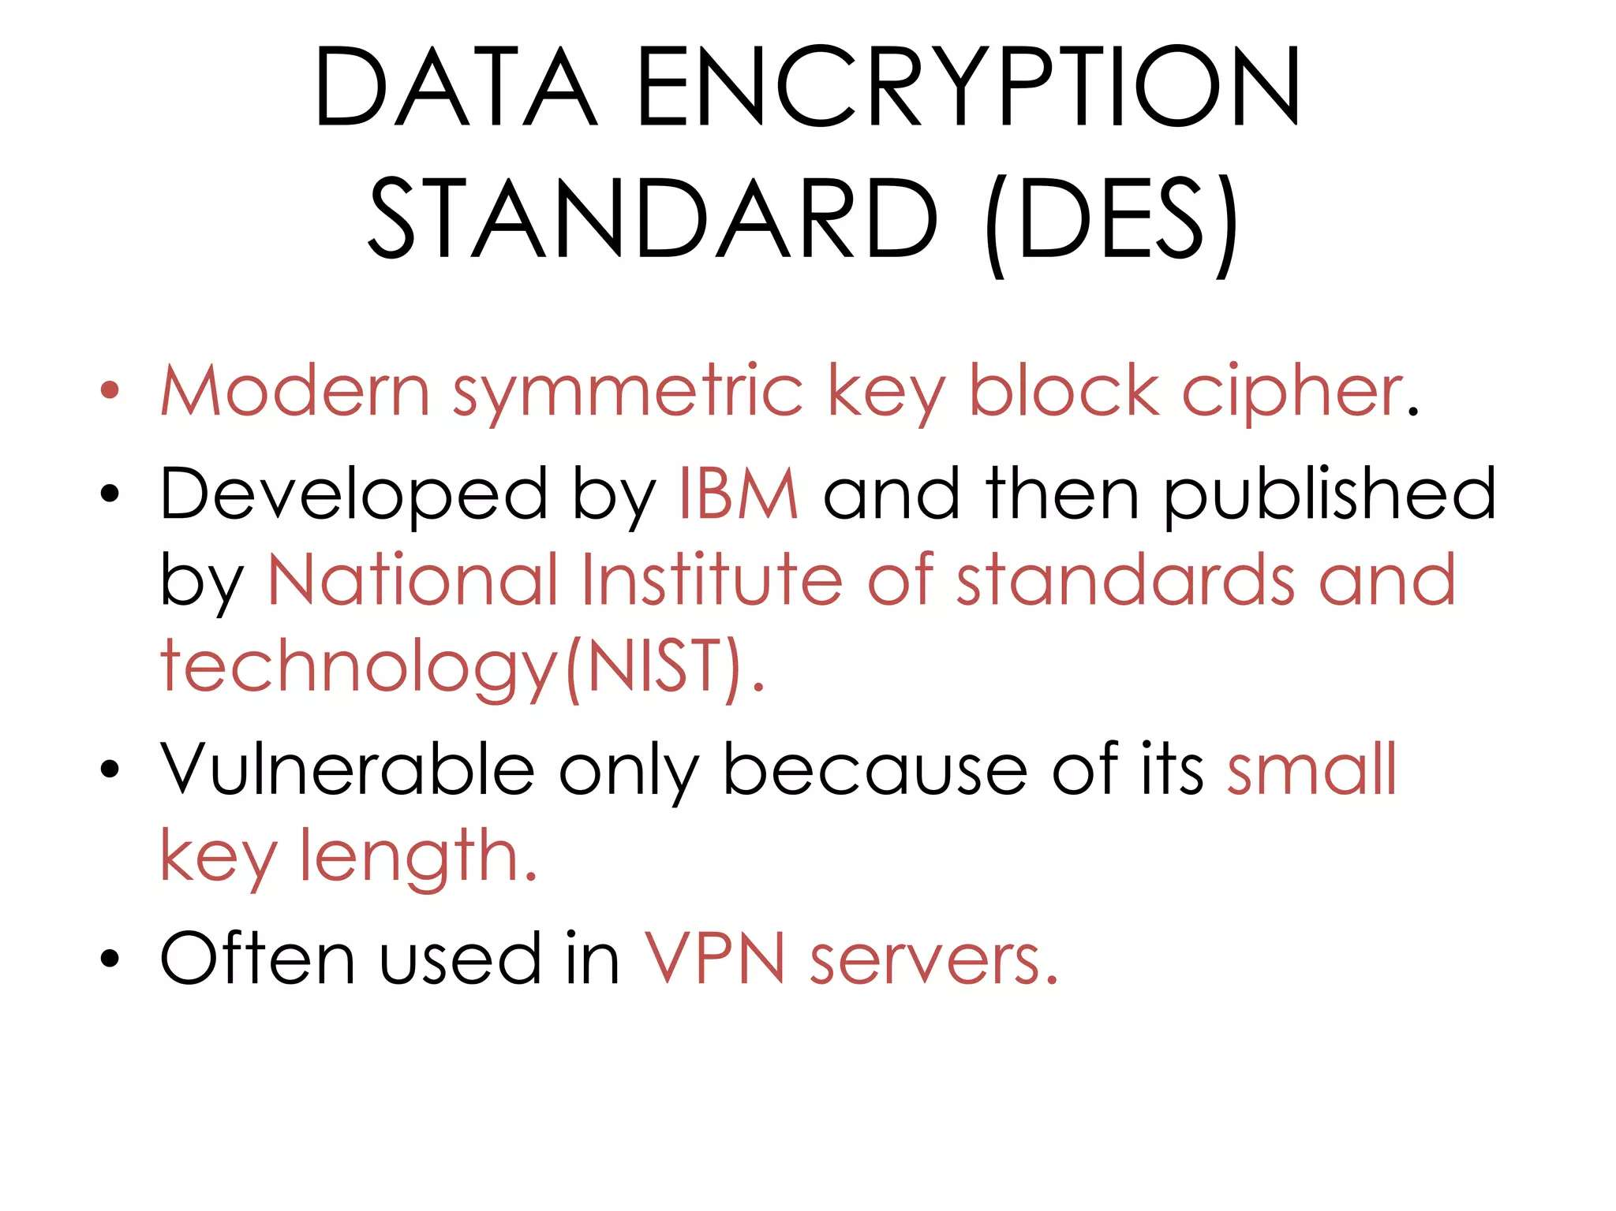

Slide 17
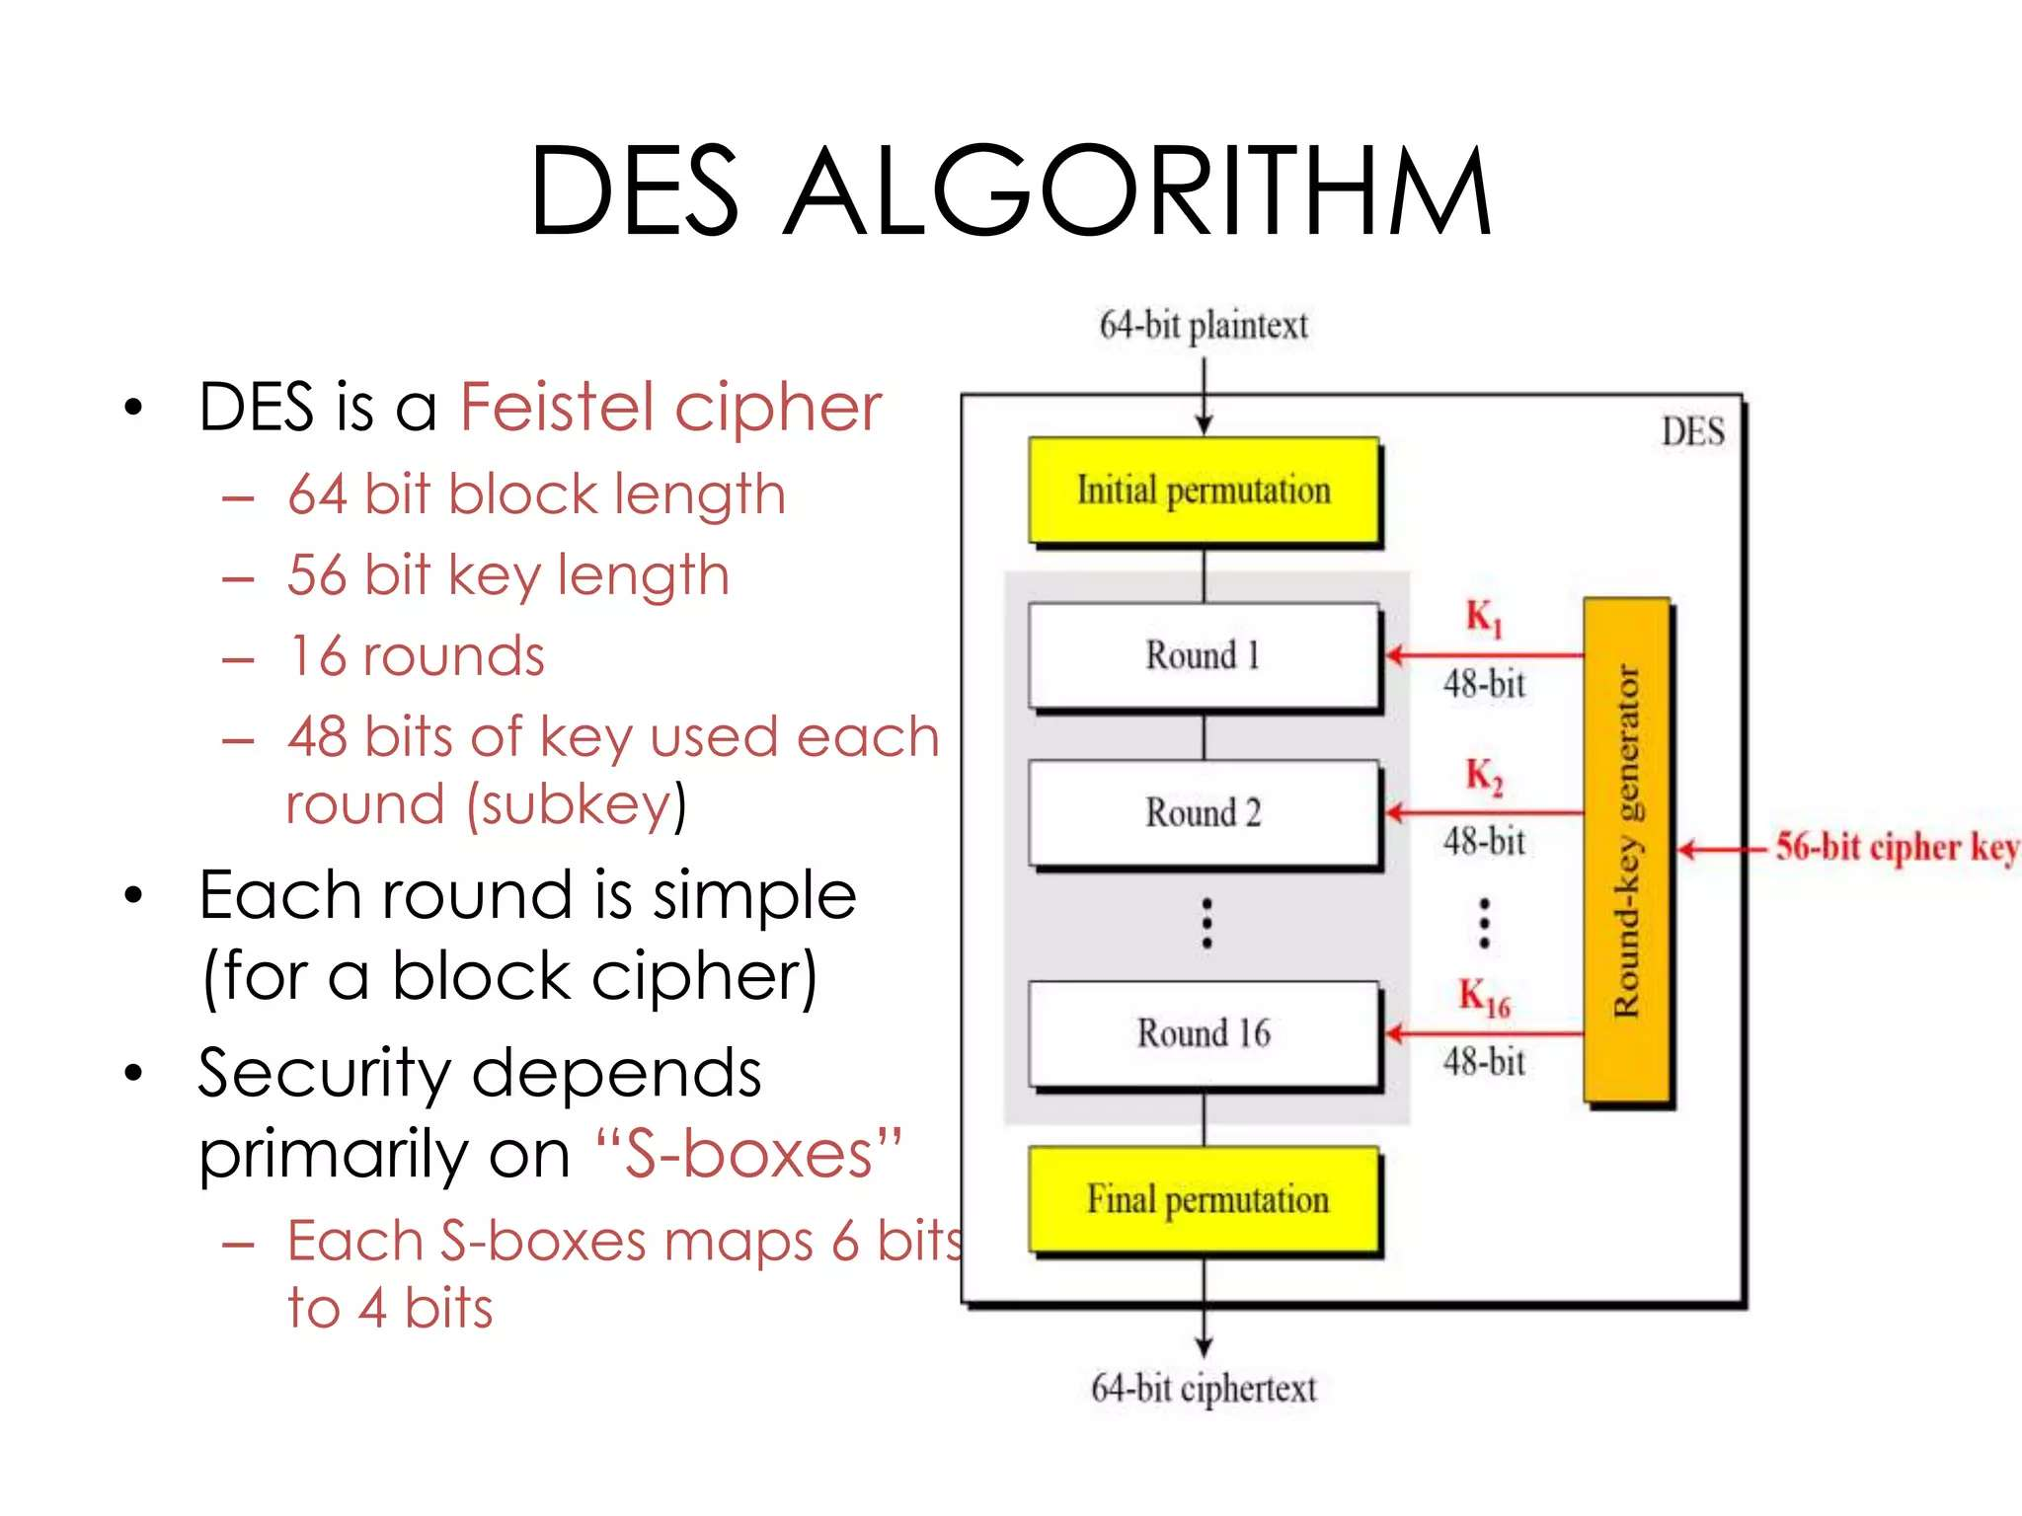

Slide 18
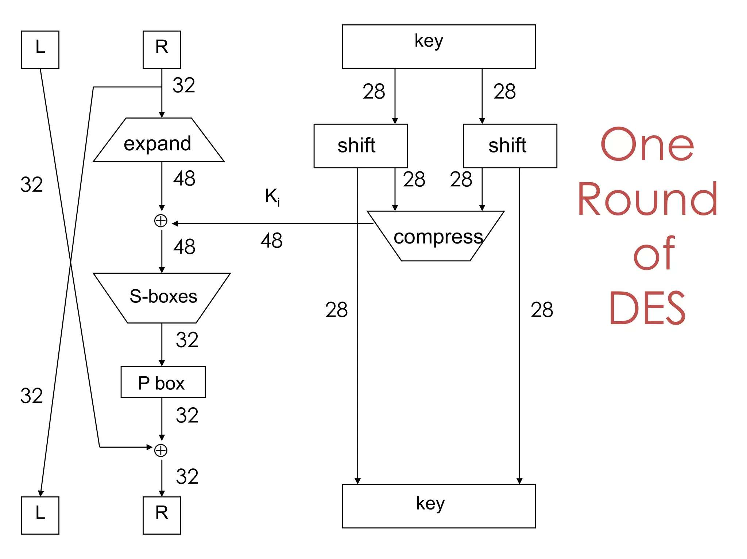

Slide 19
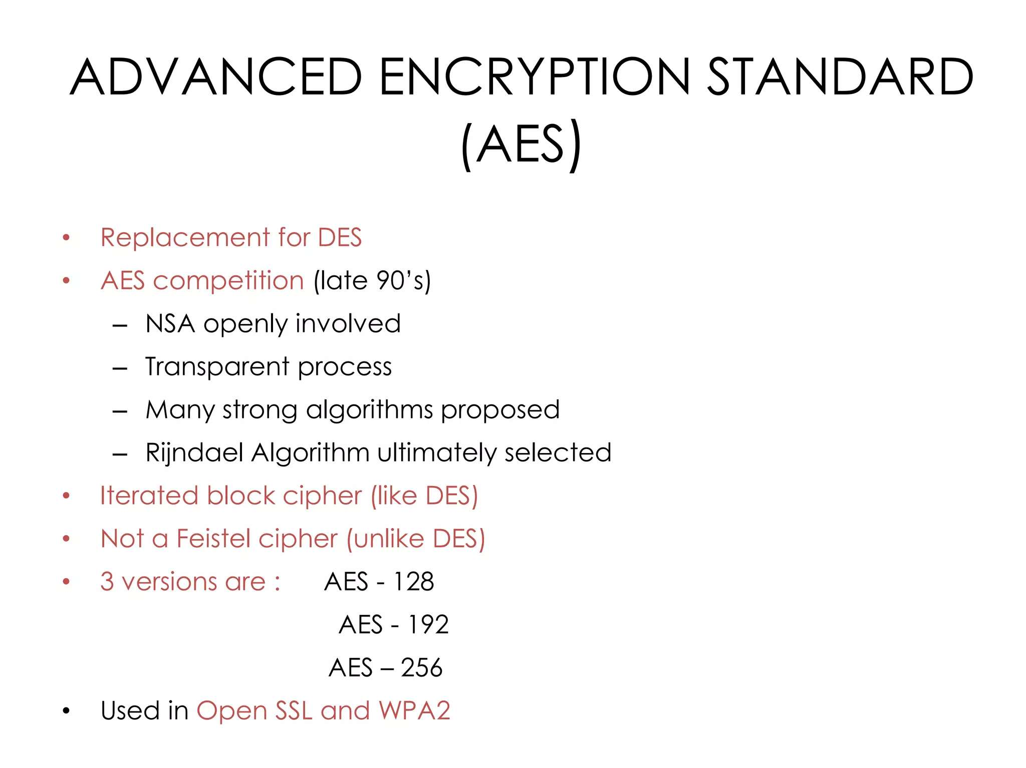

Slide 20
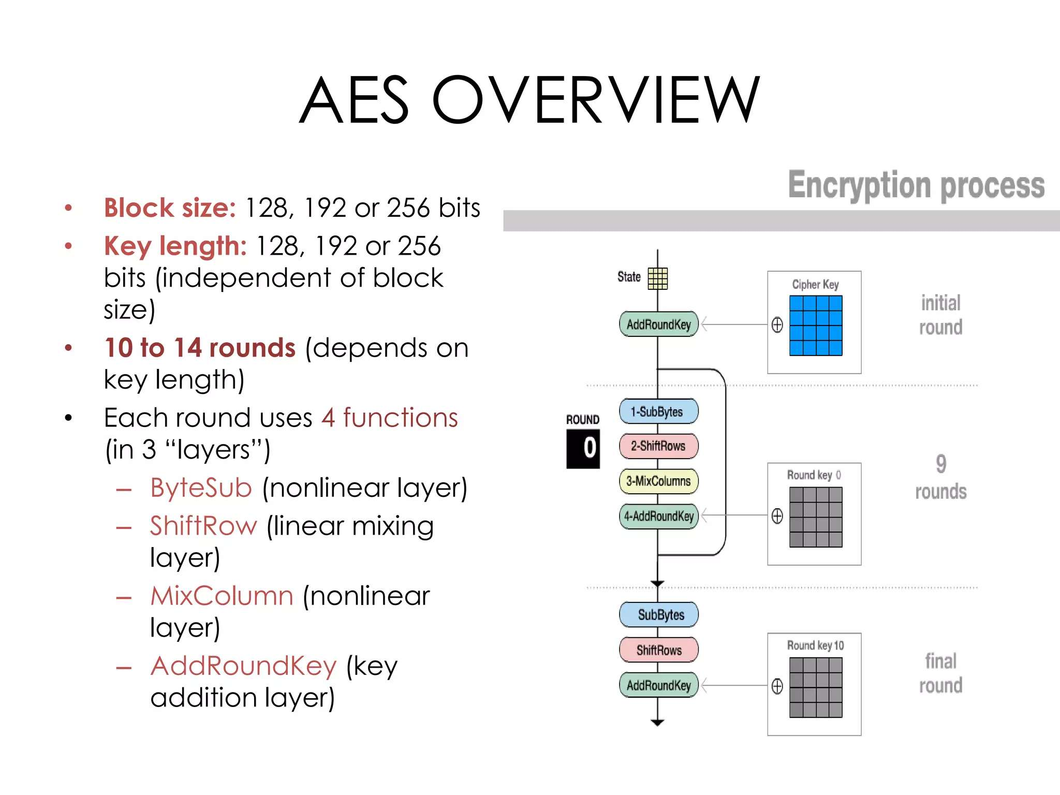

Slide 21
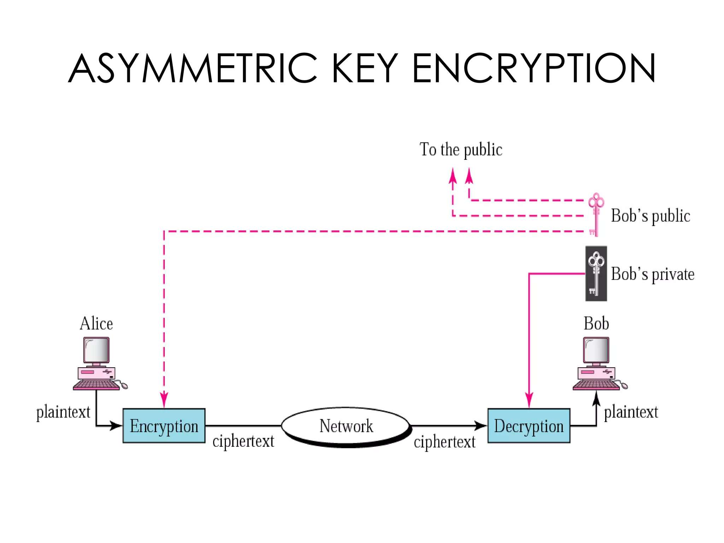

Slide 22
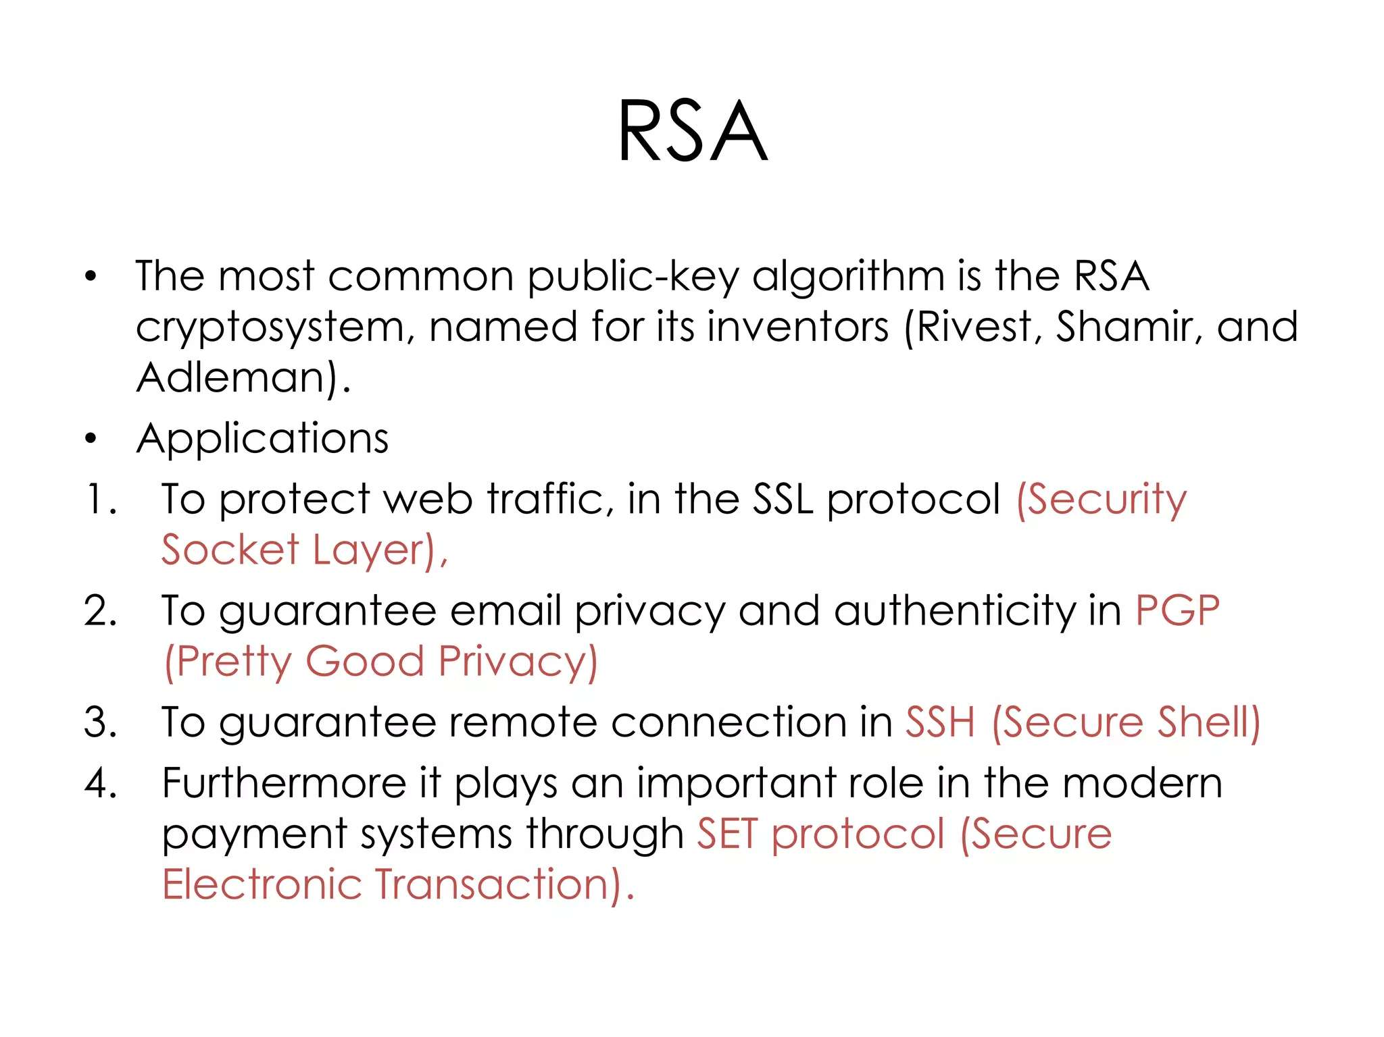

Slide 23
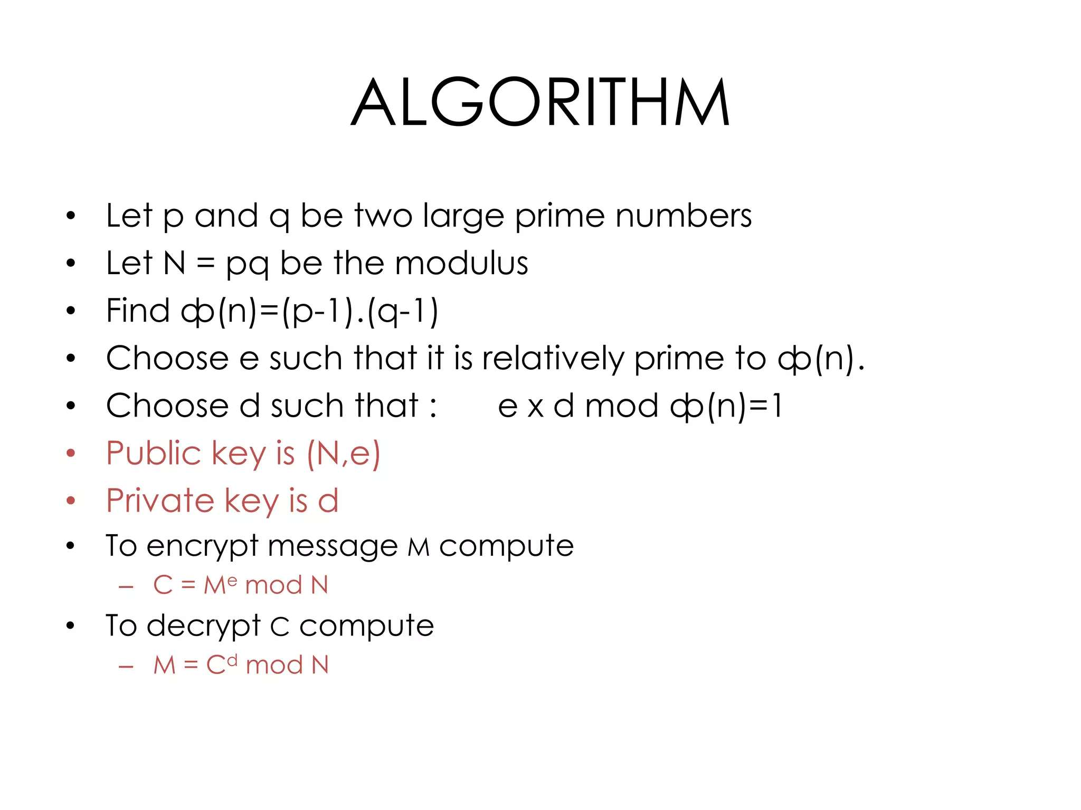

Slide 24
RSA -Example
Select primes: p=17 & q=11
Compute n = pq =17×11=187
Compute ø(n)=(p–1)(q-1)=16×10=160
Select: e=7
Determine d= 23
Publish public key KU={7}
Keep secret private key KR={23}

Slide 25
RSA
Encryption: The key is used to convert a plain-text to a cypher-text; M′= E (M, k)
M′= (M^e) mod n
Decryption: The key is used to convert the cypher-text to the original plain text;
M = D (M′, k) = M= (M’^d) mod n

Slide 26
Cryptographic primitives - blockchain
Basic cryptographic primitives behind blockchain
technology
– Cryptographically Secure Hash Functions
– Digital Signature
Hash Function: Used to connect the “blocks” in a
“chain” in a tamper-proof way
Digital Signature: Digitally sign the data so that no one can “deny” about their own activities. Also, others can check whether it is authentic.

Slide 27
Cryptographic Hash Functions
Takes any arbitrarily sized string as input
Input M: The message
Fixed size output (We typically use 256 bits in Blockchain)
Output H(M): We call this as the message digest.
Efficiently computable

Slide 28
Cryptographic Hash Functions: Properties
Deterministic
Always yields identical hash value for identical input data
Collision-Free
If two messages are different, then their digests also differ
• Hiding : Hide the original message; remember about the avalanche effect
Puzzle-friendly : Given X and Y, find out k such that Y = H(X|| k) - used to solve the mining puzzle in Bitcoin Proof of Work
http://www.blockchain-basics.com/HashFunctions.html

Slide 29
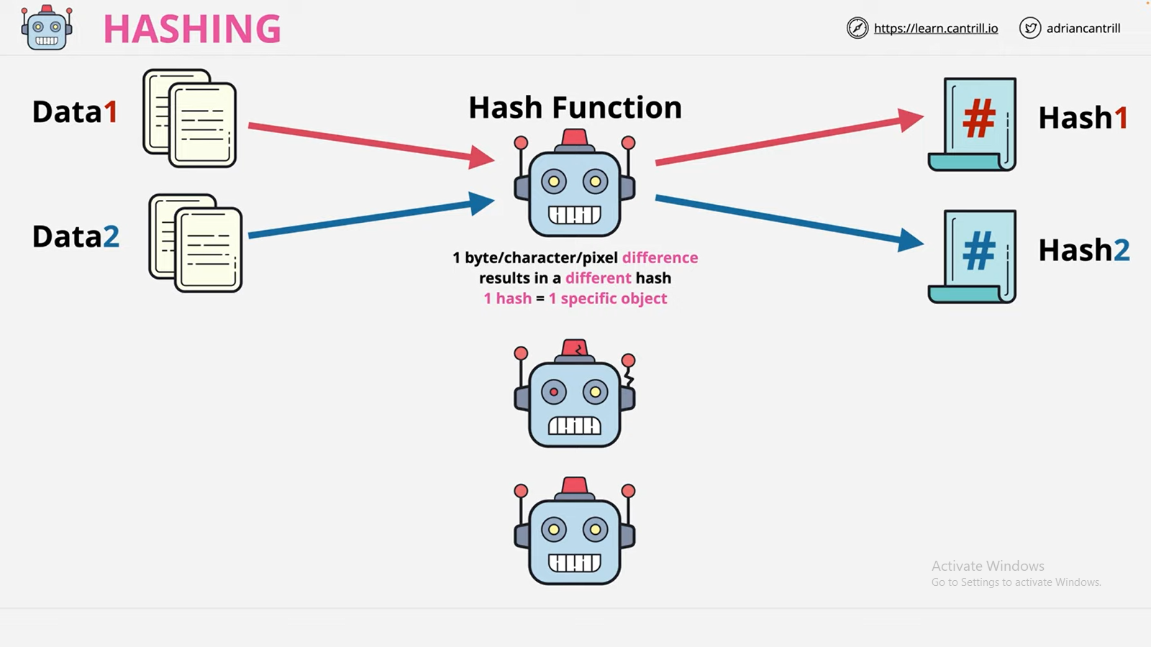
No two data will have a same hash value.

Slide 30
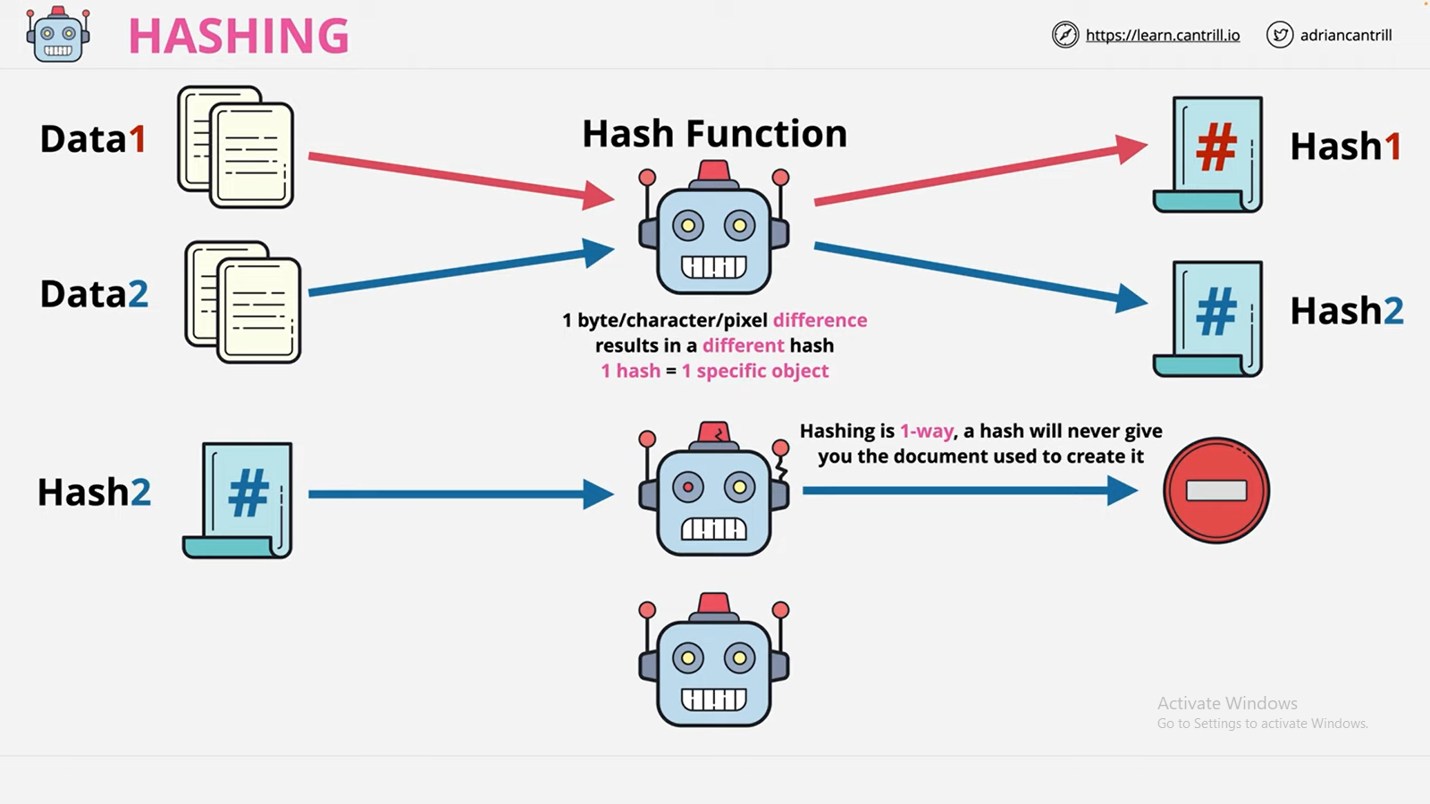
By sending Hash as input, we cannot get the original data.

Slide 31
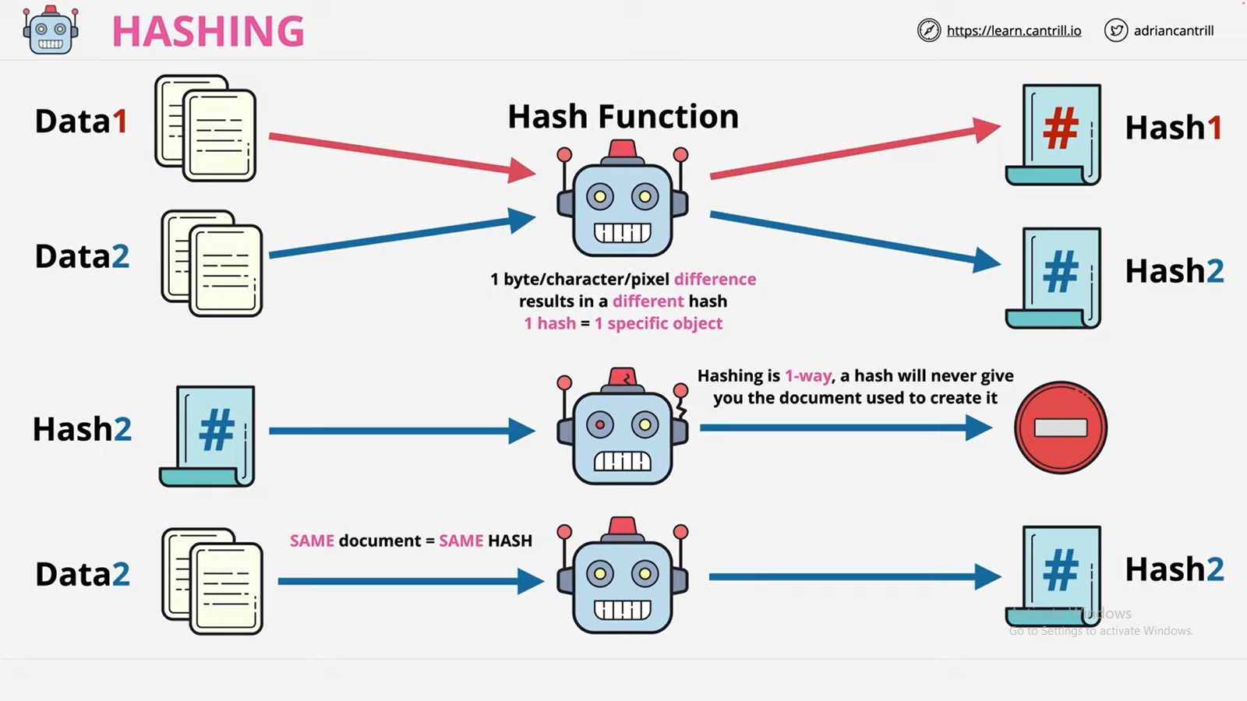
Same data, we will get the same Hash.

Slide 32
Hash functions
Hash functions are used to create fixed-length digests of arbitrarily-long input strings.
Hash functions are keyless, and they provide the data integrity service.
They are usually built using iterated and dedicated hash function construction techniques. Various families of hash functions are available, such as MD, SHA-1, SHA-2, SHA-3, RIPEMD, and Whirlpool.
Hash functions are commonly used for digital signatures and Message Authentication Codes (MACs), such as HMACs.
They have 3 security properties
preimage resistance
second preimage resistance and
collision resistance.

Slide 33
Hash functions
It is Easy to compute
Preimage resistance: h(x) = y; h is the hash function, x is the input, and y is the hash.
The first security property requires that y cannot be reverse-computed to x. x is considered a preimage of y, This is also called a one-way property.
Second preimage resistance: given x and h(x), it is almost impossible to find any other message m, where m != x and h(m) = h(x).
This property is also known as weak collision resistance.

Slide 34
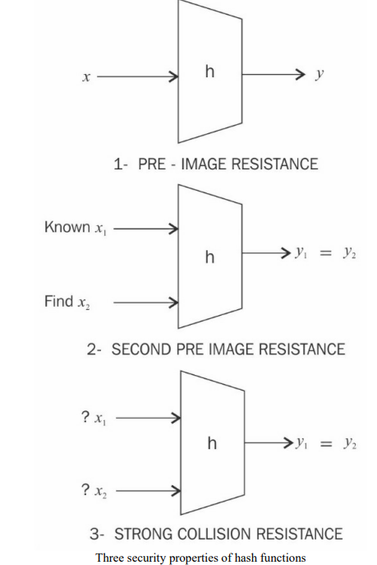
Hash functions
Collision resistance: requires
that two different input
messages should not hash to
the same output. In other
words, h(x) != h(z).
This property is also known
as strong collision resistance.

Slide 35
Hash functions
SHA-0: This is a 160-bit function introduced by NIST in
1993.
SHA-1: was introduced in 1995 by NIST as a replacement for SHA-0. This is also a 160-bit hash function. SHA-1 is used commonly in SSL and TLS
implementations.
SHA-2: This category includes four functions defined by the number of bits of the hash: SHA-224, SHA256, SHA-384, and SHA-512.
SHA-3: This is the latest family of SHA functions.
SHA-3-224, SHA-3-256, SHA-3-384, and SHA-3- 512 are members of this family.

Slide 36
Hash functions
RIPEMD: is the acronym for RACE Integrity Primitives Evaluation Message Digest. It is based on the design ideas used to build MD4.
There are multiple versions of RIPEMD, including 128-bit, 160-bit, 256-bit, and 320-bit.
Whirlpool: This is based on a modified version of the Rijndael cipher known as W. It uses the MiyaguchiPreneel compression function, which is a type of one-way function used for the compression of two fixed length inputs into a single fixed-length output.

Slide 37
Hash functions
Hash functions have many practical applications ranging from simple file integrity checks and password storage to use in cryptographic protocols and algorithms.
They are used in hash tables, distributed hash tables, bloom filters, virus fingerprinting, peer-to-peer file sharing, and many other applications.
Hash functions play a vital role in blockchain. The PoW function in particular uses SHA-256 twice in order to verify the computational effort spent by miners.
RIPEMD 160 is used to produce Bitcoin addresses.

Slide 38
MD5
MD5 is quite fast and produces 128 bit message digest
After some initial processing the input text is processed in 512 bit of blocks.
This 512 bit blocks are divided into 16, 32 bit sub blocks (16 x 32 = 512)
The output is set of 4 x 32 bit blocks = 128 bits message digest

Slide 39
Working of MD5
Padding
Append length
Divide the input into 512 bit blocks
Initialize chaining variables
Process blocks

Slide 40
Step 1: Padding
The aim of this step is to make the length of the original message equal to a value which is 64 bit less than the exact multiple of 512
512 512-64 448
512 x 2 1024-64 960
512 x 3 1536-64 1472

Slide 41
Original Message
Padding (1-512 bits)
Original Message Padding
Total length should be 64 bit less than the exact multiple of 512
If 448 bits ( 448 = 512 – 64)
If 960 bits ( 960 = 2 x 512 -64)
If 1472 bits (1472 =3 x 512- 64)
Note: Padding is always added even if it is in terms of 512

Slide 42
Step 1 cont’d
If message length is 1000 add 472 = 1472
If message length is 448 add 512 = 960 , even though 448 is 64 bits less than multiple of 512
Reason
512 512-64 448
512 x 2 1024-64 960
512 x 3 1536-64 1472

Slide 43
Step 2: Append length
The length of the original message is Calculated and is appended to the end of the message block + padding

Slide 44
Original Message
Padding
length
Original Message Padding Length
Data to be hashed
64 bits
The length of the original message (excluding the padding) is calculated
It is appended to the end of the message block + Padding
The length is expressed in 64 bits
If the length of the message exceeds 2⁶⁴ bits of length then only last 64
bits are used. (by taking mod 64)
After 64 bit of length is appended this becomes the final message
This final message is to be hashed
The length of the message is in terms of 512 bits

Slide 45
Step 3: Divide the i/p into 512 bits blocks
DATA TO BE HASHED
BLOCK 1
BLOCK 2
BLOCK N
512 bits
512 bits
512 bits

Slide 46
Step 4 – Initialize chaining variables
Four variables called as chaining variables are initialized
They are called as A B C and D
Each of these is a 32 bit number
The initial hex values are
A Hex 01 23 45 67
B Hex 89 AB CD EF
C Hex FE DC BA 98
D Hex 76 54 32 10

Slide 47
Step 5
After all the initializations the real algorithm begins
Its quiet complicated , we will discuss it step by step
There is a loop that runs for as many 512 bit blocks as are in the message

Slide 48
Step 5.1 : Process blocks
Copy the 4 chaining variables into 4 corresponding variables a ,b ,c, d
A -> a
B -> b
C -> c
D -> d
abcd
128 bit single register

Slide 49
Step 5.2 Divide
Divide the current 512 bit block into 16 sub blocks M [i]
Blk | 512 bits
SB1
SB2
SB16
32 bits
32 bits
32 bits

Slide 50
Step 5.3
There are 4 rounds.
In each round process all the 16 sub blocks
Inputs to each round are
All the 16 sub blocks
a, b, c, d
Some constants (t)

Slide 51
t
t is an array of constants
It contains 64 elements with each element consisting of 32 bits
t[1] , t[2] ……..t[64]

Slide 52
What is done in these four rounds?
All the four rounds vary in one major way
STEP 1 of the rounds has different processing
The other steps in all the four rounds are the same
In each round we have 16 input sub blocks names M[0] , M[1], …. M[15] each of 32 bits
We have t[k] , k varies form I to 64,
16 out of 64 values of t is used in each round

Slide 53
Iterations on all 4 rounds
After copying abcd we have 16 such iterations
Process P is performed on b,c,d . This process P is different in all the four rounds

Slide 54
Process P
A
B
C
D
PROCESS P
Process P: some basic Boolean operations on b,c,d
Round Process P
1 (b AND c) OR ((NOT b) AND (d))
2 (b AND d) OR (c AND (NOT d))
3 (b XOR c XOR d)
4 c XOR (b OR (NOT d))

Slide 55
The variable a is added to the output of process P
The message sub block M[i] is added to the output of step 2 i.e. to the register abcd
The constant t[k] is added to the output of step 3 i.e. to the register abcd
The output of step 4 is circular left shifted by s bits
The variable b is added to the output of step 5
The output of step 6 now becomes abcd for the next step

Slide 56
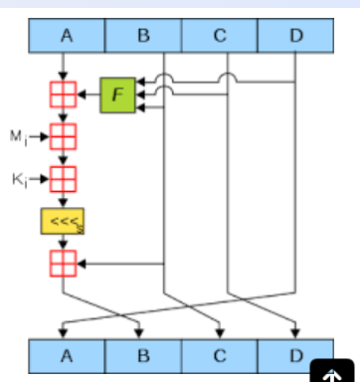
MD5

Slide 57
Mathematically expressing MD5
b = b + (( a + process P(b,c,d) + M[i] + T[k] <<< s )
abcd – chaining variables
Process P – A non linear operation
M[i], t[i] – Sub blocks, constants
<<< s – Circular left shift by s bits

Slide 58
Strength of MD5
The possibility that 2 messages producing the same message digest using MD5 is in the order of 2⁶⁴

Slide 59
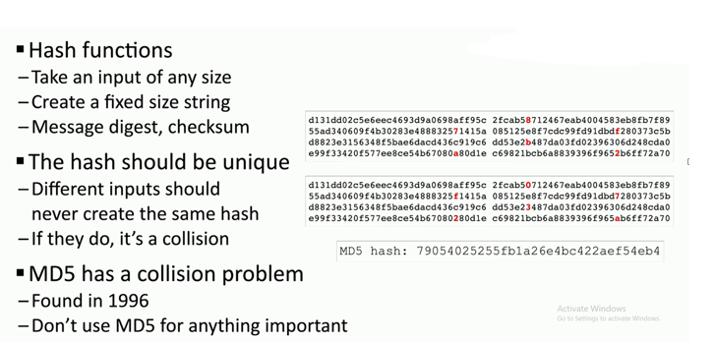
Collision Problem in MD5

Slide 60
Design of SHA-256
SHA-256 has the input message size < 2 64 -bits. Block size is 512-bits, and it has a word size of 32-bits.
The output is a 256-bit digest. The compression function processes a 512-bit message block and a 256-bit intermediate hash value.
There are two main components of this function: the compression function and a message schedule.

Slide 61
Design of SHA-256
Preprocessing
Padding of the message is used to adjust the length of a block to 512-bits if it is smaller than the required block size of 512-bits.
Parsing the message into message blocks, which ensures that the message and its padding is divided into equal blocks of 512-bits.
Setting up the initial hash value, which consists of the eight 32-bit words obtained by taking the first 32-bits of the fractional parts of the square roots of the first eight prime numbers.
These initial values are randomly chosen to initialize the process, and they provide a level of confidence that no backdoor exists in the algorithm.

Slide 62
Design of SHA-256
2. Hash computation:
Each message block is then processed in a sequence, and it requires 64 rounds to compute the full hash output.
Each round uses slightly different constants to ensure that no two rounds are the same.
The message schedule is prepared.
Eight working variables are initialized.
The intermediate hash value is calculated.
Finally, the message is processed, and the output hash is produced

Slide 63
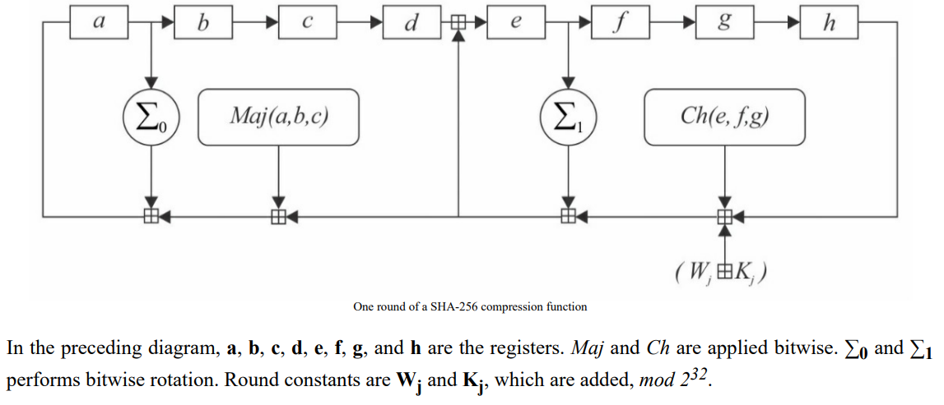
Design of SHA-256

Slide 64
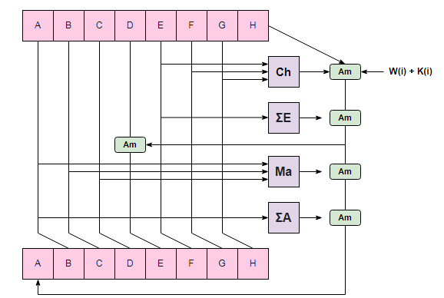
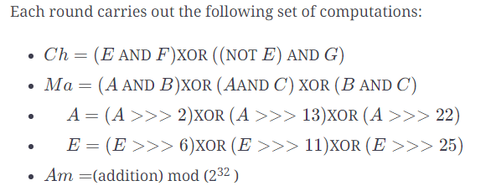
SHA-256

Slide 65
SHA Versions
 | SHA-1 | SHA-224 | SHA-256 | SHA-384 | SHA-512
Message digest size | 160 | 224 | 256 | 384 | 512
Message size | < 2⁶⁴ | < 2⁶⁴ | < 2⁶⁴ | < 2¹²⁸ | < 2¹²⁸
Block size | 512 | 512 | 512 | 1024 | 1024
Word size | 32 | 32 | 32 | 64 | 64
Number of steps | 80 | 64 | 64 | 80 | 80
Notes:
Stallings Table 11.3 provides a comparison of the various parameters for the SHA hash functions.

Slide 66
Digital Signatures
We have looked at message authentication
But does not address issues of lack of trust
Digital signatures provide the ability to:
– Verify author, date and time of signature
– Authenticate message contents
– Be verified by third parties to resolve disputes
• Hence include authentication function with
Additional capabilities

Slide 67
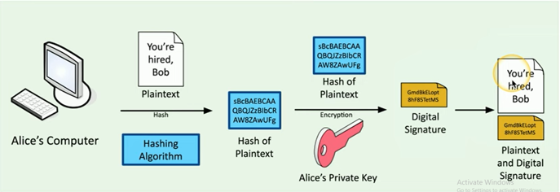
Digital Signatures

Slide 68
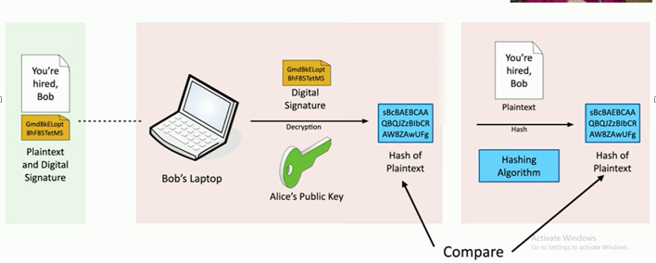
Digital Signatures - Verify the Signature

Slide 69
Digital Signature Requirements
Must depend on the message signed
Must use information unique to sender
To prevent both forgery and denial
Must be relatively easy to produce
Must be relatively easy to recognize and verify
Be computationally infeasible to forge
- With new message for existing digital signature
- With fraudulent digital signature for given message
Be practical to save digital signature in storage

Slide 70
THANK YOU

